Slide 1
Database Partitioning and Replication

Slide 2
Why do we want them?
Partitioning and replication are essential database concepts that help manage large data volumes, optimize performance, and ensure availability.

Slide 3
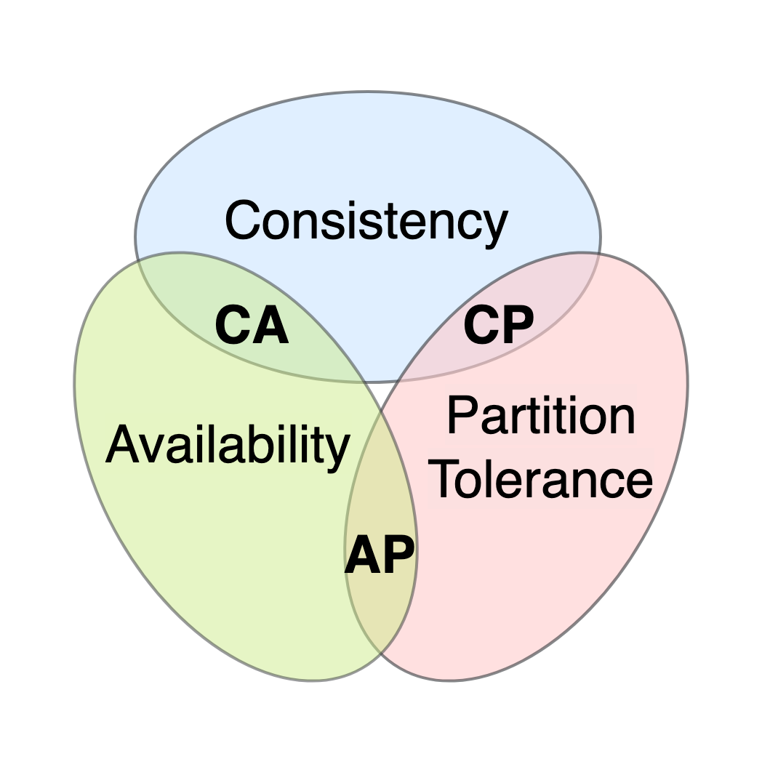
CAP Theorem

Slide 4
What is it?
Partitioning: The process of dividing a database into distinct, independent parts. Each partition holds a subset of data.
Replication: The process of copying data across multiple database instances to enhance data availability and reliability.

Slide 5
Partitioning
Advantages:
Improved Query Performance: Queries can focus on specific partitions, reducing the volume of data scanned.
Better Resource Management: Load is distributed across different servers or disks, enhancing system performance.
Increased Scalability: Allows horizontal scaling, letting you add storage and compute power as data grows.

Slide 6
Challenges with Partitioning:
Skewed Data: If data isn’t distributed evenly, some partitions can become “hotspots” with more load than others.
Complexity: Queries and joins become more complex since data resides in separate partitions.
Data Consistency: Synchronizing updates across partitions can add complexity.

Slide 7
Types of Partitioning
Range Partitioning:
Partitions data based on ranges of a key field (e.g., date, numeric range).
Use Case: Sales data split by year or month for easy retrieval and deletion of old data.
Hash Partitioning:
Uses a hash function on a key field to distribute data evenly across partitions.
Use Case: Balances data evenly, especially useful when data access patterns are unpredictable.
List Partitioning:
Divides data based on specific values of a key field.
Use Case: Partitioning customer data by region, where each partition corresponds to a geographical area.
Composite Partitioning:
Combines multiple partitioning strategies, such as range-hash or range-list.
Use Case: Combines benefits of two strategies, e.g., range partitioning for dates and hash for distributing workload evenly within each date range.

Slide 8
Database Replication
Advantages:
High Availability: Ensures continuous data availability, especially during server failures.
Improved Read Performance: Allows read operations to be distributed across multiple replicas, reducing load on the primary server.
Data Recovery: Replication can act as a disaster recovery solution by maintaining up-to-date copies of data in multiple locations.

Slide 9
Challenges with Replication:
Consistency: Keeping replicas synchronized with each other is challenging, especially with high write loads.
Conflict Resolution: Master-master setups require conflict resolution mechanisms when data changes conflict.
Latency: Synchronous replication can introduce latency in applications sensitive to real-time responses.

Slide 10
Types of Replication
Master-Slave Replication:
A primary (master) database serves write requests, and one or more replicas (slaves) serve read requests.
Use Case: High-read, low-write workloads where data consistency requirements are moderate.
Master-Master Replication:
Two or more databases can serve both read and write requests.
Use Case: Systems requiring high availability and where nodes are in close proximity to reduce conflict resolution issues.
Synchronous vs. Asynchronous Replication:
Synchronous: Data changes are immediately replicated. Ensures strong consistency but has higher latency.
Asynchronous: Data changes are eventually replicated. Has lower latency but may cause temporary inconsistencies.
Use Case: Synchronous is used for critical applications needing immediate consistency, while asynchronous fits applications prioritizing performance over immediate consistency.
Multi-Region Replication:
Replicates data across geographically distributed data centers.
Use Case: Improves data access speed for globally distributed users, as they access data from the nearest data center.

Slide 11
Challenges and Trade-offs
Partitioning: May improve performance but can add complexity in query management and increase development time.
Replication: Offers high availability but at the cost of potential data inconsistencies in distributed setups.
CAP Theorem: Highlights the trade-off between Consistency, Availability, and Partition tolerance in distributed databases.

Slide 12


